Slide 1
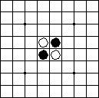
Reversi (Othello)
CENG466 – Artificial Intelligence
PRESENTED TO:
Dr.Roya CHOUPANI
PRESENTED BY:
Baran Yiğit-201711071

Slide 2
Abstract
Game Idea
Min-Max Algorithm
Maximizing the computer’s behavior, and minimizing the opponent.
Reversi or Othello is a strategy board game played between 2 players on 8x8 uncheckered board.
Alpha-Beta Pruning
Almost impossible to generate and examine complete tree.
Less time, less complexity.

Slide 3
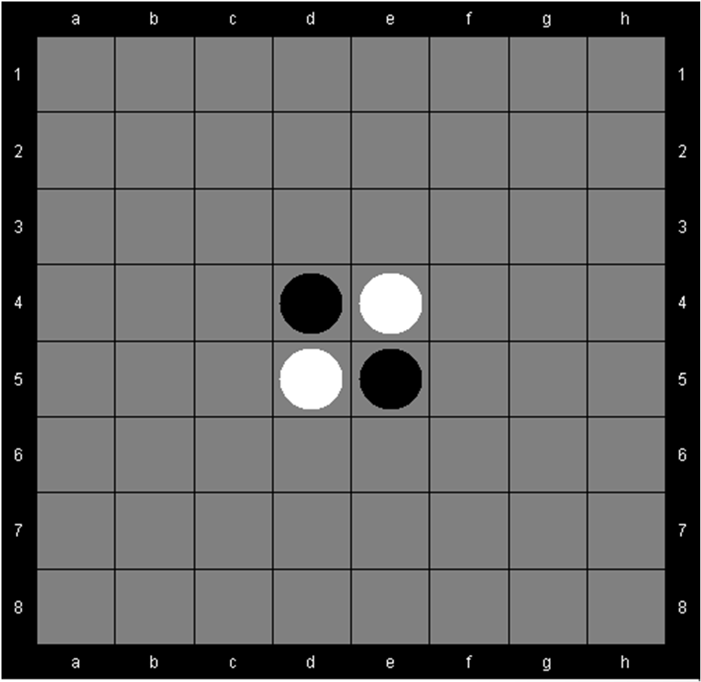
Reversi
  Two Players (Black and White)
  8x8 board
  Black plays first
  Every move should ‘Flip’ over at least one opponent disk
  Goal: Maximize ones disks
Initial board

Slide 4
Information
It has a smaller search space than chess, usually 5 to 15 legal moves.
In 1997, the Logistello program defeated the human world champion, Takeshi Murakami, by six games to none.
It is generally acknowledged that humans are no match for computers at Reversi.

Slide 5
Characteristics
It does not have random elements in its rule.
Every gained advantage of a player is equal to the gained disadvantage of their opponent. (zero-sum games)
Its evaluation function evaluates the “goodness” of game position.
All of the players are perfectly informed of every previous event in the game.

Slide 6
Goal: Have most disks on the board at the end of the game.
Players alternate placing disks on unoccupied board spaces.
If opponent’s disks are trapped between other player’s disks, opponent’s disks are flipped to the other player’s color.

Slide 7
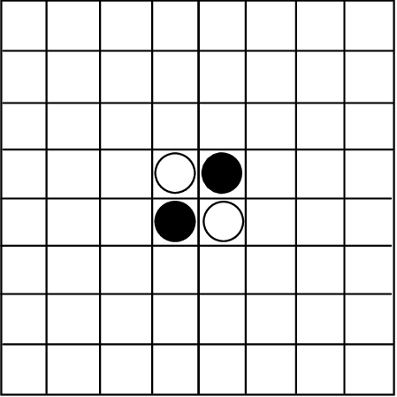
In games like Go, Dots or Reversi, the winner is determined with a score and not according to the player making the last move.

Slide 8
Technical Description
Two-player deterministic zero-sum game with perfect information.
Game tree size is approximately 10⁵⁶.
State space size (legal positions) is approximately 10²⁸.
Branching factor is approximately 10.
Max move length is 60.

Slide 9
Othello 4 x 4
Othello 4x4 has a very small game tree and has been solved in less than one second by many simple Othello programs that use the Min-max method, which generates all possible positions (nearly 10 million). The result is that white wins with a +16 margin.

Slide 10
Othello 10 x 10
In a 10x10 Othello board, the starting player (black) is more likely to win. 10x10 has a longer mid-game. Computer analysis shows that a draw is highly likely if both players play perfectly.
The game tree complexity is very high, estimated to be 10⁹⁰, with the number of legal positions estimated at 10⁴⁴.

Slide 11
Othello is strongly solved on 4x4 and 6x6 boards, with the second player (white) winning in perfect play. Although mathematically unsolved, it is practically solved on a standard 8x8 board as well.

Slide 12
Reversi: Rules and Game Play
The object of the game is to have the majority of your colour discs on the board at the end of the game.
  Black places two black discs and White places two white discs as shown in here.
  A move consists of "outflanking" your opponent's disc(s), then flipping the outflanked disc(s) to your colour.
  To outflank means to place a disc on the board so that your opponent's row (or rows) of disc(s) is bordered at each end by a disc of your colour.

Slide 13

Outflanking Example
White disc A was already in place on the board. The placement of white disc B outflanks the row of three black discs.
White flips the outflanked discs and now the row looks like this:

Slide 14
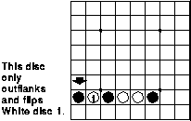
Game Rules
Black moves first.
If on your turn you cannot outflank and flip at least one opposing disc, your turn is forfeited and your opponent moves again.
A disc may outflank any number of discs in one or more rows in any number of directions at the same time - horizontally, vertically or diagonally.

Slide 15
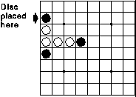
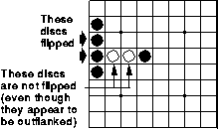
Game Rules
Discs may only be outflanked as a direct result of a move and must fall in the direct line of the disc placed down.
All discs outflanked in any one move must be flipped, even if it is to the player's advantage not to flip them at all.
Once a disc is placed on a square, it can never be moved to another square later in the game.

Slide 16
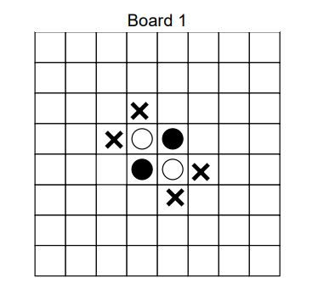
Game Play
This is the starting configuration. Black always moves first, and the Xs show black’s legal moves. Black must always sandwich one or more white pieces. In general, if a player can’t sandwich at least one, they lose their turn and the other player makes a move. The game is over when neither player can make move.

Slide 17
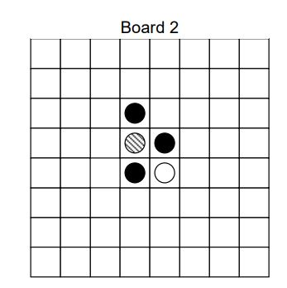
Game Play
Black decides to place a piece on the upper-most X. That sandwiches one white piece (the shaded one), which then gets changed to black. Reversi pieces are white on one side, and black on the other, so we say color has flipped.

Slide 18
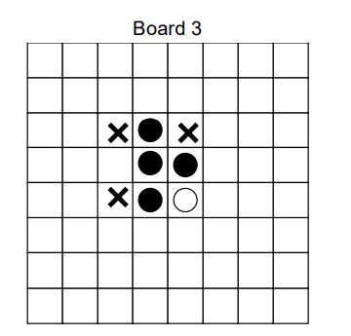
Game Play
After the piece is flipped, the board looks like this. Black has four pieces, and white has one. The Xs show the legal places white can place a piece.

Slide 19
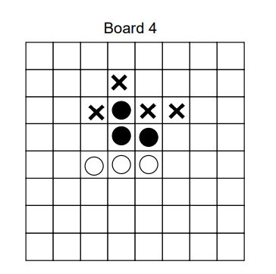
Game Play
White has moved to the lower left X, and after flipping the sandwiched white piece. The Xs show black’s legal moves. The game continues in the same fashion.

Slide 20
Logic
a) (I W) or (I B): informs you that you are playing WHITE or BLACK.
b) (W c r) or (B c r): informs you that your opponent has played at [c r]. If you are W, then use (B c r). If you are B, use (W c r).
c) (W) or (B): informs you that your opponent has passed, because he has no legal move.
d) (n): informs you that your opponent claims that the game is over, and has the value n for BLACK.

Slide 21
a) (R W) or (R B): in response to an (I color) input, indicating that you are ready for the first move.
b) (W c r) or (B c r): making a move.
c) (W) or (B): passing because you have no legal move.
d) (n): claiming the end of the game.

Slide 22
We will describe a move as a triple: (color column row).
For example, a possible first move of the game is (W D 3), meaning that a white piece is placed in column D (the fourth from the left), and it occupies row 3 (the third from the bottom). This would result in the black piece at (D,4) being converted to a white piece It would then be player 2's turn.
A possible move for Black would be (B C 3), placing a black piece in column C, row 3. This results in the white piece at (D,4) being converted to a black piece.

Slide 23
Evaluation function
One of the most critical components of the search algorithm is the heuristic function, which evaluates the strength and overall desireability of a given board position.

Slide 24
Disc Difference: Since the goal of the game is to have more discs than the opponent, one would think that a good evaluation function would simply compute the two players disc balance at each search node.

Slide 25
Mobility : Restrict your opponent’s mobility and to mobilize yourself. This ensures that the number of potential moves that your opponent has would drastically decrease, and your opponent would not get the opportunity to place coins that might allow him/her to gain control.

Slide 26
Corner Squares: Corners are the four squares a1, a8, h1 and h8. The speciality of these squares is that once captured, they cannot be flanked by the opponent. There is a high correlation between the number of corners captured by a player and the player winning the game.

Slide 27
Stability: Stability of coins is a key factor in Othello. The stability measure of a coin is a quantative representation of how vulnerable it is to being flanked.

Slide 28
Parity: Measures who is expected to make the last move of the game. Has zero weight in the opening, but increases to a very large weight in the midgame and endgame.

Slide 29
Square Weights: Assigns weights to squares so as to avoid giving the opponent a corner. The static board implicitly captures the importance of each square on the board.

Slide 30
If we want to find a good move, we need to compare the boards that are the result of different moves.
Agent cannot distinguish a board that has a good chance to win from a board that is about to lose.
But Agent understands numbers!
We need a heuristic function from boards to numbers.

Slide 31
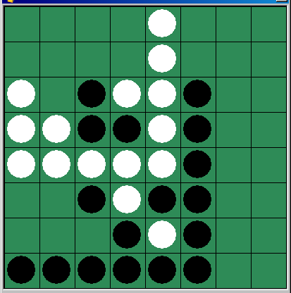
Heuristic Function
Reversi (Othello)
  Board value of based on piece positions
    Corners very valuable (can’t be flipped)
    Sides somewhat valuable (very difficult to flip)
    Middle little value (will easily be flipped)
  Low branching factor (5 to 15 possible moves)
  Good heuristics
  Single move can greatly change board
    Hard for human player to see
    Easy for Min-Max look-ahead to see

Slide 32
Heuristics-based players
Min-max
  The min-max algorithm with alpha-beta pruning can be used to determine which move was optimal given the evaluation function.
Three Heuristics based players can be created
  Positional
  Mobility
  Absolute

Slide 33
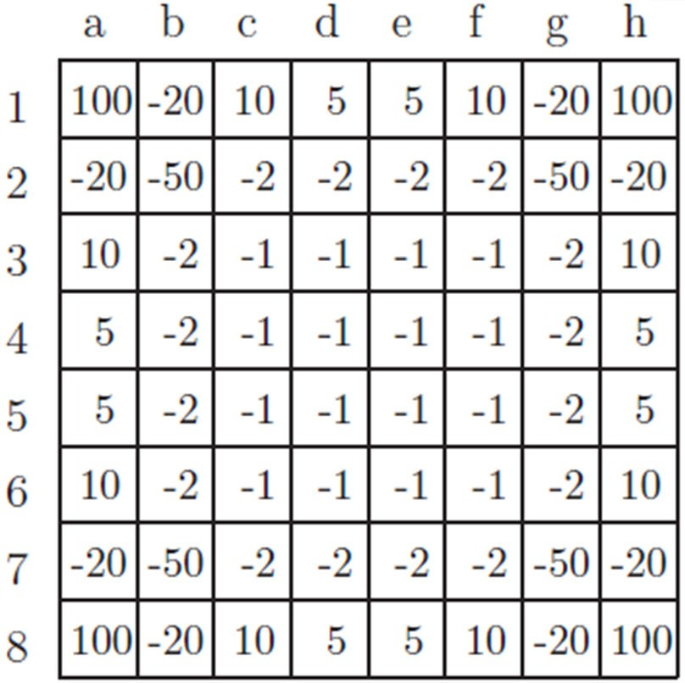
Strategies
Positional
  Maximize its own valuable positions (such as corners and edges) while minimizing its opponent’s valuable positions.
  Evaluation Function :
^{w}a1^{v}a1 ^{+ w}a2^{v}a2 ^{+ … + w}a8^{v}a8 ^{+ … + w}h8^{v}h8
w_{i} is +1, -1 or 0 if the square is occupied by player, opponent or empty
Weights

Slide 34
Strategies - 2
Mobility
  Number of Legal Moves a player can make in a particular position.
  Maximize own mobility and minimize opponents mobility.
  Corner square are important in mobility.
  Evaluation Function :
^{10 * c}player ^{− c}opponent
c is corner squares
₊ ₍^{n}player ^{– n}opponent₎
^{n}player^{+ n}opponent

Slide 35
Strategies -3
Absolute
  Maximize ones own disks
  Evaluation Function:
^{n}player ^{− n}opponent

Slide 36
Game Phases
An Othello game can be split into three phases where strategies can differ:
  Beginning
    First 20 to 25 moves
  Middle
  End
    Last 10 to 16 moves
Usually heuristic players use Positional/Mobility for beginning and middle phases. Then switch to Absolute for the end phase.

Slide 37
The most natural strategy that many primitive computer Othello players employed was to base their move on a greedy strategy that tried to maximize the number of coins of a player at any point.
A single move can flank at most 18 coins, which implies that games can change from the control of one player to another very rapidly.

Slide 38
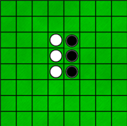
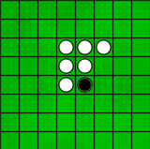
The nature of Reversi is such that the score can be completely reversed in only few turns.
Here is a simple example:
The score changed from (3 - 3) to (6 - 1) in one move.

Slide 39
The root of the tree is the initial game state that is, the Othello game before the first move is made. The children of this initial state are all of the possible states that can arise from the black player making a valid opening move.

Slide 40
Min-max
Specifically in the Othello game, we can apply Minmax algorithm based on the value of difference between number of white pieces and black pieces. In that way, we know user will be aiming for the maximum value and our AI will aim for the opposite.

Slide 41
Min-max
Min-max explores all possible moves of the first player, simulating those moves, and exploring the possible moves of the second player in response.
The algorithm searches for the smallest score during the second player's simulated responses, and the largest scores during its own simulated moves, thereby discovering which moves will maximize his own score and minimize his opponent's.

Slide 42
Alpha-Beta Pruning
Alpha-beta pruning is a search algorithm that decreases the number of nodes needed to be evaluated by the minimax algorithm. This algorithm stops evaluating a particular move when at least one possibility has been found that renders the move to be worse than a previously examined move available for the current player.

Slide 43
Alpha-Beta Pruning
As a result, the returned solution from minimax without alpha-beta pruning will be identical to the solution from min-max with alpha-beta pruning.
The major difference is the amount of time saved by reducing the number of expanded nodes in the search algorithm.

Slide 44
  Time Limit There is a 60 second time limit for a player to make his move. (user time)
  Move preconditions (if not passing)
    Color is W if it is player 1's turn and B if it is player 2's turn.
    There is no piece at column, row.
    (column, row) is a valid board location (A <= column <= H, 1 <= row <= 8).
    There is a sequence of opponent pieces followed by your piece starting from column, row in at least one of eight directions. If not, the turn is lost and the other player goes again.
  Move postconditions (if not passing)
    After the move, the place at column and row on the board will be occupied by a color piece.
    For each of eight directions any sequence of opponent pieces followed by your piece starting at column, row is converted to a color piece.
    It will be the other player's turn.
  Move preconditions (if column = P)
    There is no open (col,row) with a necessary sequence of opponent pieces followed by your piece starting there.
  Move postconditions (if column = P)
    The board configuration remains unchanged.
    It will be the other player's turn.

Slide 45
The game ends in any of the following cases:
  The board is full. The player with the most pieces wins the game. If the number of pieces is equal, then the game is a draw.
  Neither player can make a legal move, the player with the most pieces wins.
  A player makes an illegal move - the other player wins.
  A player fails to move within the time limit - the other player wins.

Slide 46
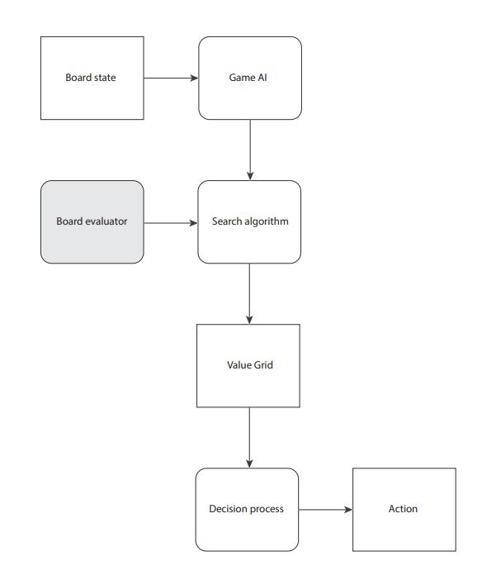


Slide 47
Flip
Current
Color
Game
Over
Flip
Current
Color
N
Legal
Move?
N
Current
Color =
White
Legal
Move?
Y
Y
Update
Board
Enable
Move
Move selected
Move selected’

Slide 48
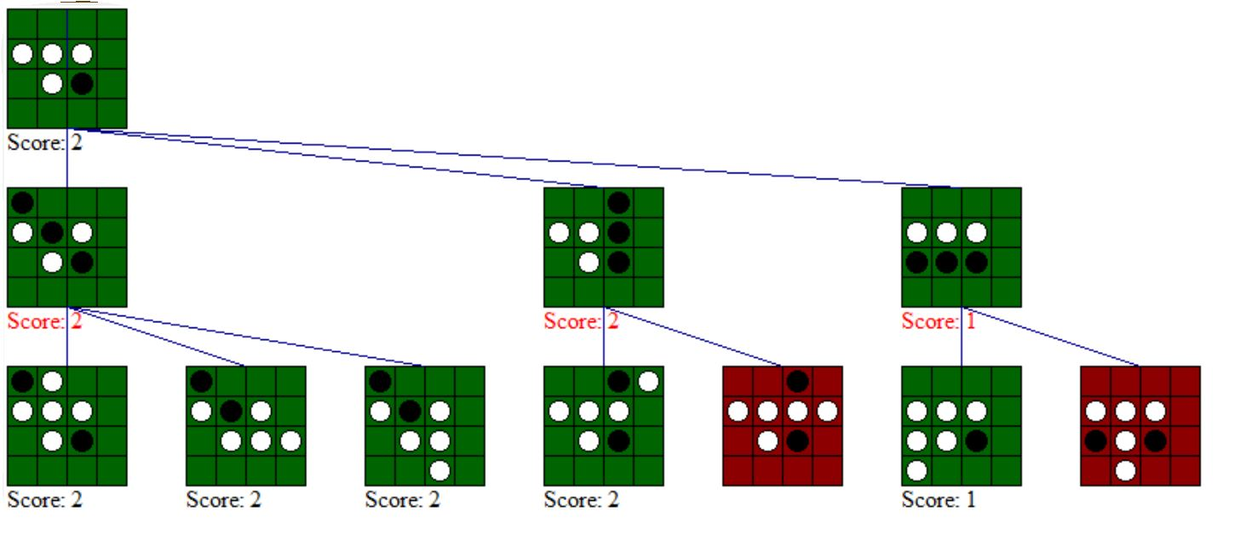

Slide 49
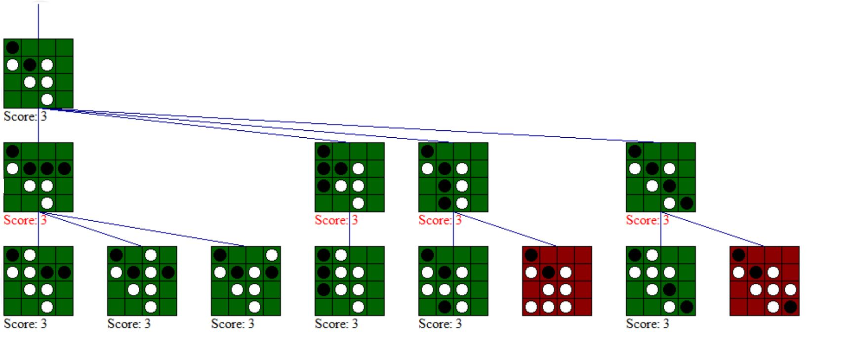

Slide 50
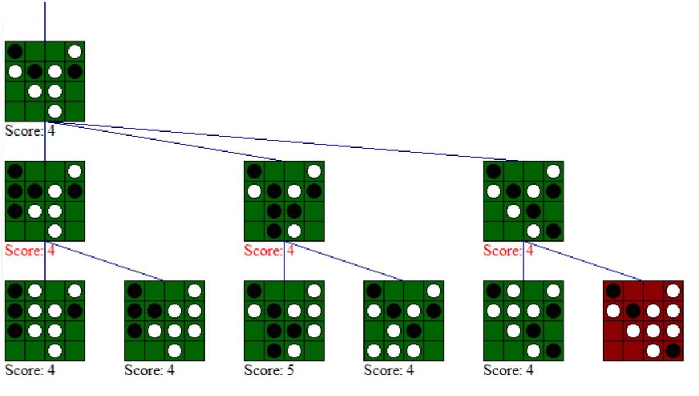

Slide 51
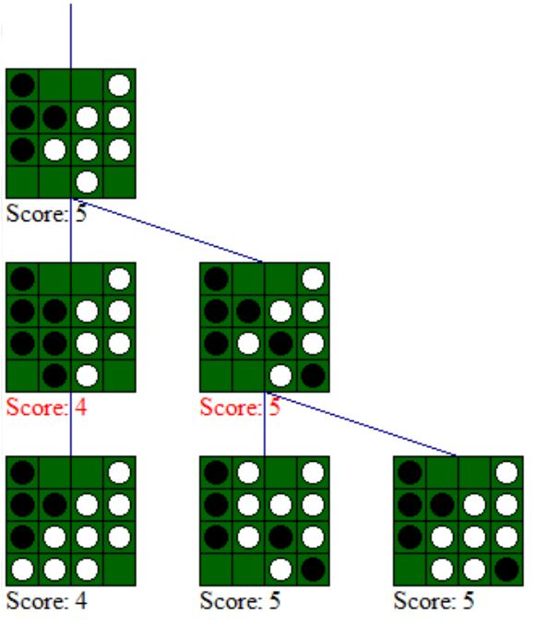

Slide 52
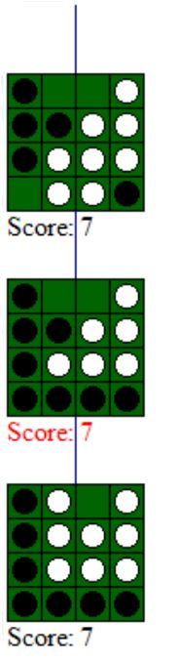

Slide 53
Originating and Continuing a Run
Begins a black run
Continues a white run
Begins a white run

Slide 54
Legal Moves
Legal to move white
Legal to move black

Slide 55
Consideration for Cell
  Originates a white (black) run:
    Cell is white (black); and
    Neighbor in direction is black (white);
  Continues a white (black) run
    Cell is white (black); and
    Neighbor in direction continues or originates a white (black) run

Slide 56
Two Functions Per Color and direction
Remote
  Black: this square is white
  all the squares in some direction are white until we hit a black
  Reverse black|white for Remote White
RemoteOrLocal
  Black: this square is black | remoteBlack is true for this square
Note that if a square is empty both remote and remoteOrLocal are false.

Slide 57
Originating and Continuing a Run
remoteWhiteEast
remoteOrLocalBlack (all directions)
remoteOrLocalBlack East
remoteOrLocalWhite (all directions)
remoteOrLocalBlackWest
remoteBlackWest
remoteOrLocalWhite (all directions)
remoteOrLocalBlackWest
remoteBlackWest

Slide 58
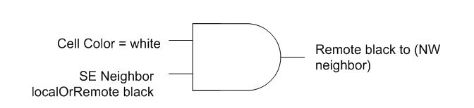
RemoteBlack (Continue White Run)

Slide 59
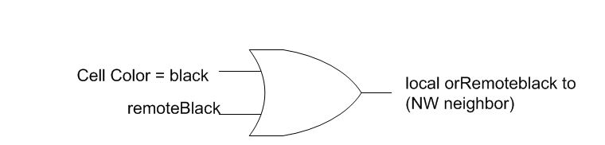
RemoteOrLocal black (on white run or neighbor can start white run)

Slide 60
Legal Move
Move to a square is legal if and only if
  Current Mover is white (black)
  CurrentState(empty)
  Some neighbor continues a black (white) run – neighbor’s remoteWhite (black)

Slide 61
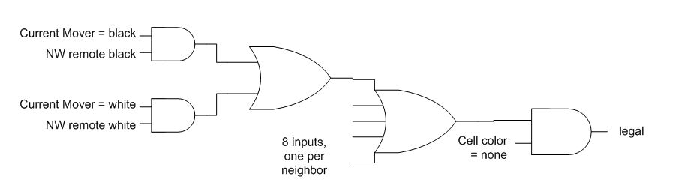
Representation of Legal Move

Slide 62
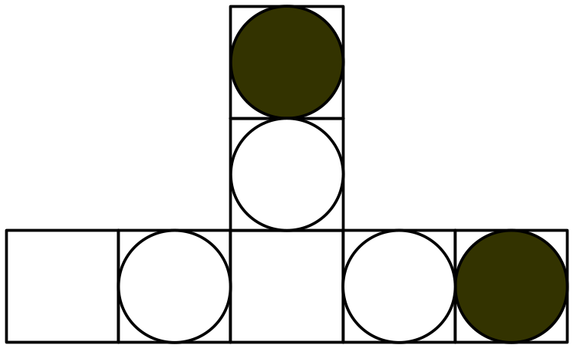
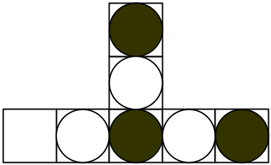
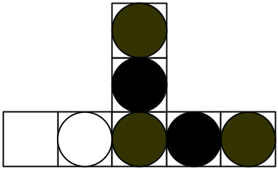
Flipping
Move
Flip

Slide 63
Flipping
Move = black
RemoteBlackNorth = True
RemoteBlackEast = True
Square selected

Slide 64
Flip black if
  Flip black signal from one direction (SE); and (Λ)
  Color(white); and (Λ)
  remoteBlack is true in other direction (NW)
  FlipBlackNW = [FlipBlackFromSE Λ Color=white Λ RemoteBlackNW
  Send FlipBlackNW out to NW neighbor
  OR(|) all(∀) FlipBackDirections to get Direction

Slide 65
Propositional Logic
The first is Othello where the plain goal to possess more stones than the opponent was found to be a bad heuristics.
P(holds(true(cell(5, 5, black)), t)|holds(true(cell(5, 5, black)), s)) ≈ P(holds(¬true(cell(5, 5, black)), t)|holds(true(cell(5, 5, black)), s))
The only exception to this are the border and the corner stones that are much more stable since there are few (corner stones: zero) ways to turn them.

Slide 66
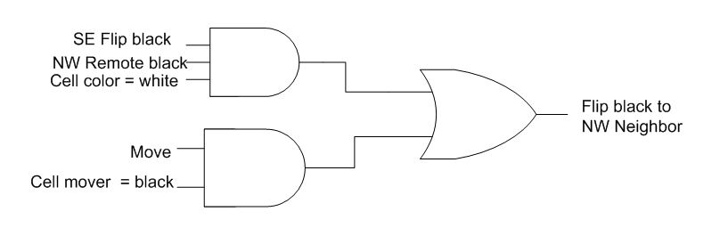
Flip Calculation

Slide 67
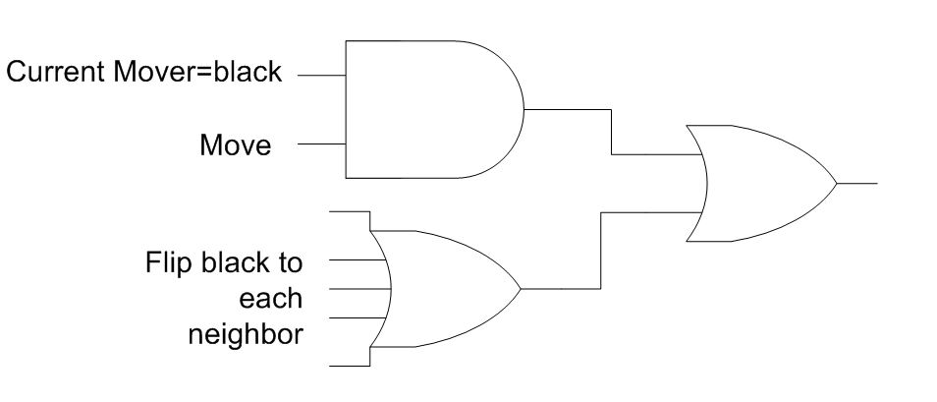
Representation of Next Cell State
Next state=Black (repeat for White)

Slide 68
Knowledge Base
Iteration 1
  Contain the definition of the operators
  Contain the moves
Iteration 2
  More game logic stored so functions can be defined to the algorithm information.
Iteration 3
  All game logic contained in KB.

Slide 69
System Developed Iteratively
  Knowledge base will contain moves and algorithm information.
  Game logic contained in controller moved to knowledge base.
  All player logic stored in knowledge base.

Slide 70
Game Controller
  Present player agent with list of possible moves.
  Take move from player agent and control board.
Then, a lot of this logic will be contained in the KB.

Slide 71
Player Agent
Consult strategy to return a move to the Game Controller.
  It will give agent all possible moves to chose from.
  It will give agent copy of the board, and the agent will find and chose move.

Slide 72
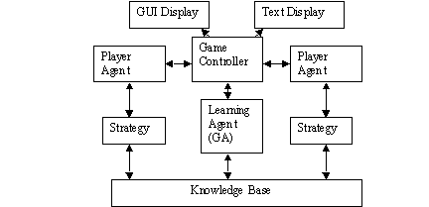
System Design

Slide 73
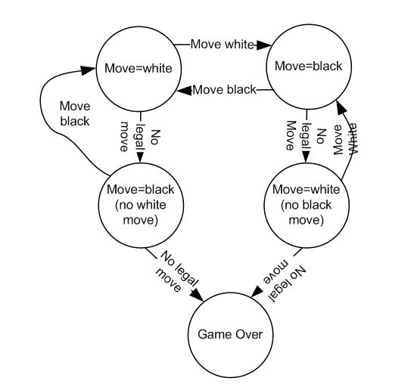
Game Control Logic

Slide 74
Conclusion
The min-max search algorithm is the basic algorithm to search the game tree.
Min-max recursively evaluates a position by taking the best of the values for each child position.
Alpha-beta pruning is an extremely important improvement to minimax that greatly reduces the number of nodes in the game tree that must be searched.

Slide 75
        Thanks for listening.
        Questions?

